Slide 1
Collection Framework

Slide 2
Collection
The Collection in Java is a framework that provides an architecture to store and manipulate the group of objects.
Java Collections can achieve all the operations that you perform on a data such as searching, sorting, insertion, manipulation, and deletion.
Java Collection means a single unit of objects.
Java Collection framework provides many interfaces (Set, List, Queue, Deque) and classes (ArrayList, Vector, LinkedList, PriorityQueue, HashSet, LinkedHashSet, TreeSet).

Slide 3
What is Collection in Java?
A Collection represents a single unit of objects, i.e., a group.
What is a framework in Java
It provides readymade architecture.
It represents a set of classes and interfaces.
It is optional.

Slide 4
What is Collection framework
The Collection framework represents a unified architecture for storing and manipulating a group of objects. It has:
Interfaces and its implementations, i.e., classes
Algorithm

Slide 5
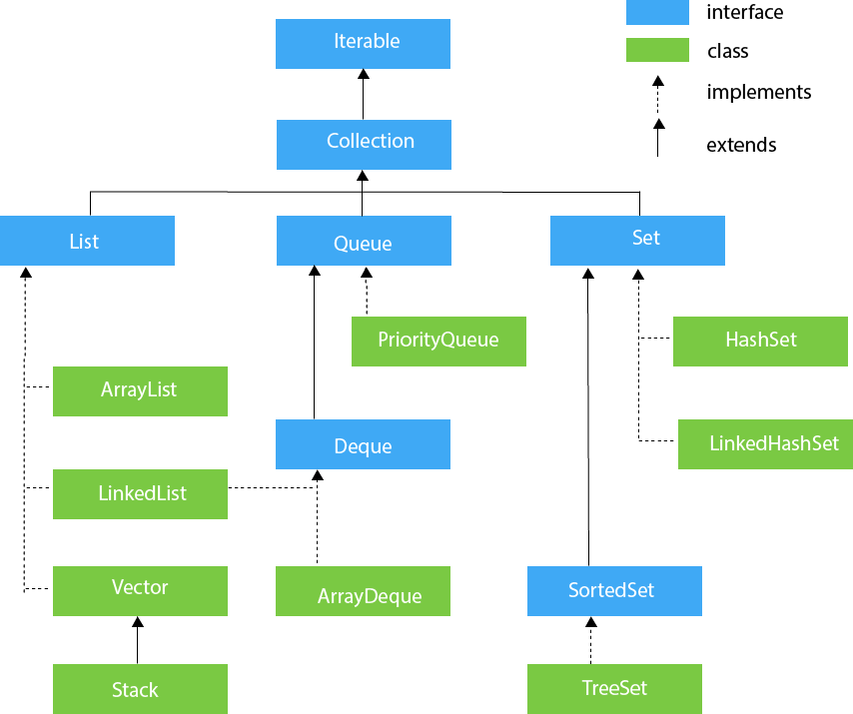
Hierarchy of Collection Framework

Slide 6
Class Vs Interface
Class | Interface
A class is a user-defined prototype for building objects in Java. | An interface is a user-defined blueprint that describes the structure of every class that implements it.
It is used to define objects. | It cannot be used to define objects.
A class can have access modifiers public and default. | An Interface can have access modifiers public and default.
Classes can be concrete or abstract. | All interfaces are abstract.
A class consists of constructors, methods and attributes. The methods are defined in a class. | An interface consists attributes and methods. The methods are not defined in an interface, it only contains their signature.

Slide 7
Iterable
The iterable interface is the root of the entire collection hierarcy, which means that every class and interface implements it.
The primary function of an iterator is to allow the user traverse through all the collection class objects as if they were simple sequences of data items.

Slide 8
Commmand for show all the methods in Collection package:
javap java.util.Collection

Slide 9
ArrayList
The ArrayList class implements the List interface. The objects of this class are dynamic arrays.
The ArrayList is essentially a resizable implementation of List. It implements all of the List methods and allows all elements even null elements.
The ArrayList objects have a capacity, which is initially equal to the size but increases dynamically as new elements are added.
An ArrayList is unsynchronised, which means multiple threads can access them at the same time.
Syntax:
ArrayList<?> arrayListName = new ArrayList<?>();

Slide 10
public class BasicArrayList{
public static void main(String[] args) {
// Instantiate an ArrayList Object
// Integer is a wrapper class for
// the basic datatype int
ArrayList<Integer> intArr = new ArrayList<Integer>();
// Add elements using add() method
intArr.add(10);
intArr.add(12);
intArr.add(25);
intArr.add(19);
intArr.add(11);
intArr.add(3);
// Print the ArrayList on the console
System.out.println(intArr);
// Remove elements at index 1
intArr.remove(1);
// Print the ArrayList on the console
System.out.println(intArr);
// Check if intArr contains the element 25
if(intArr.contains(25))
{System.out.println("The ArrayList contains 25");}
else{
System.out.println("No such element exists");}
// Use get method to get the element at index 1
int elementAt1 = intArr.get(1);
System.out.println("The Element at index 1 now is " + elementAt1);}}

Slide 11
Display Array list
for loop
for each
Iterator
List iterator

Slide 12
Iterator:
In Java, an Iterator is one of the Java cursors. Java Iterator is an interface that is practiced in order to iterate over a collection of Java object components entirety one by one.
It is free to use in the Java programming language since the Java 1.2 Collection framework. It belongs to java.util package.

Slide 13
How to use Java Iterator?
When a user needs to use the Java Iterator, then it's compulsory for them to make an instance of the Iterator interface from the collection of objects they desire to traverse over.
After that, the received Iterator maintains the trail of the components in the underlying collection to make sure that the user will traverse over each of the elements of the collection of objects.

Slide 14
Java Iterator Methods:
hasNext()
next()
remove()
forEachRemaining()

Slide 15
forEachRemaining
It is the only method of Java Iterator that takes a parameter. It accepts action as a parameter. Action is nothing but that is to be performed.
There is no return type of the method. This method performs the particularized operation on all of the left components of the collection until all the components are consumed or the action throws an exception.
Exceptions thrown by action are delivered to the caller. If the action is null, then it throws a NullPointerException.

Slide 16
Example of Iterator
import java.io.*;
import java.util.*;
public class JavaIteratorExample {
public static void main(String[] args) {
ArrayList<String> cityNames = new ArrayList<String>();
cityNames.add("Dang");
cityNames.add("Butwal");
cityNames.add("Pokhara");
cityNames.add("Kathmandu");
cityNames.add("Palpa");
// Iterator to iterate the cityNames
Iterator iterator = cityNames.iterator();
System.out.println("CityNames elements : ");
while (iterator.hasNext())
System.out.print(iterator.next() + " ");
System.out.println(); }}

Slide 17
ListIterator(Child of Iterator):
ListIterator is one of the four java cursors. It is a java iterator which is used to traverse all types of lists including ArrayList, Vector, LinkedList, Stack etc.
It is available since Java 1.2. It extends the iterator interface.
There is no current element in ListIterator. Its cursor always lies between the previous and next elements. The previous() will return to the previous elements and the next() will return to the next element.
Therefore, for a list of n length, there are n+1 possible cursors.

Slide 18
Declaration and Syntax
Declaration:
public interface ListIterator<E> extends Iterator<E>
Syntax:
ListIterator<E> listIterator()

Slide 19
Important points
It is useful for list implemented classes.
Available since java 1.2.
It supports bi-directional traversal. i.e both forward and backward direction.
It supports all the four CRUD operations(Create, Read, Update, Delete) operations.

Slide 20
Example
import java.util.*;
public class ListIteratorDemo {
public static void main(String[] args){
List<String> names = new LinkedList<>();
names.add("Welcome");
names.add("To");
names.add("Gfg");
// Getting ListIterator
ListIterator<String> namesIterator = names.listIterator();
// Traversing elements
while (namesIterator.hasNext()) {
System.out.println(namesIterator.next());
}
// for-each loop creates Internal Iterator here.
for (String s : names) {
System.out.println(s);
}}}

Slide 21
Lambda Expression
Lambda expression is a new and important feature of Java which was included in Java SE 8.
It provides a clear and concise way to represent one method interface using an expression.
It is very useful in collection library. It helps to iterate, filter and extract data from collection.
The Lambda expression is used to provide the implementation of an interface which has functional interface.
It saves a lot of code. In case of lambda expression, we don't need to define the method again for providing the implementation.
Java lambda expression is treated as a function, so compiler does not create .class file.

Slide 22
Why use Lambda Expression
To provide the implementation of Functional interface.
Less Coding
Syntax:
(argument-list)->{body}
Java lambda expression is consisted of three components:
Argument-list: It can be empty or non-empty as well.
Arrow-token: It is used to link arguments-list and body of expression.
Body: It contains expressions and statements for lambda expression.

Slide 23
Without Lambda Expression:
interface Drawable{
public void draw();
}
public class LambdaExpressionExample {
public static void main(String[] args) {
int width=10;
//without lambda, Drawable implementation using anonymous class
Drawable d=new Drawable(){
public void draw(){System.out.println("Drawing "+width);}
};
d.draw();
}}

Slide 24
Java Lambda Expression Example
interface Drawable{
public void draw();
}
public class LambdaExpressionExample2 {
public static void main(String[] args) {
int width=10;
//with lambda
Drawable d2=()->{
System.out.println("Drawing "+width);
};
d2.draw();
}}

Slide 25
LinkedList:
Linked List is a part of the Collection framework present in java.util package.
This class is an implementation of the LinkedList data structure which is a linear data structure where the elements are not stored in contiguous locations and every element is a separate object with a data part and address part.
The elements are linked using pointers and addresses. Each element is known as a node. Due to the dynamicity and ease of insertions and deletions, they are preferred over the arrays.
It also has few disadvantages like the nodes cannot be accessed directly instead we need to start from the head and follow through the link to reach to a node we wish to access.

Slide 26
Java LinkedList class uses a doubly linked list to store the elements. It provides a linked-list data structure. It inherits the AbstractList class and implements List and Deque interfaces.

Slide 27
Important points
Java LinkedList class can contain duplicate elements.
Java LinkedList class maintains insertion order.
Java LinkedList class is non synchronized.
In Java LinkedList class, manipulation is fast because no shifting needs to occur.
Java LinkedList class can be used as a list, stack or queue.

Slide 28
Constructors of Java LinkedList:
LinkedList() //It is used to construct an empty list.
LinkedList(Collection<? extends E>c) //It is used to construct a list containing the element of the specified collection, in the order, they are returned by the collection iterator.

Slide 29
Example
import java.util.*;
public class Test {
public static void main(String args[])
{
// Creating object of the
// class linked list
LinkedList<String> ll = new LinkedList<String>();
// Adding elements to the linked list
ll.add("A");
ll.add("B");
ll.addLast("C");
ll.addFirst("D");
ll.add(2, "E");
System.out.println(ll);
ll.remove("B");
ll.remove(3);
ll.removeFirst();
ll.removeLast();
System.out.println(ll);}}

Slide 30
Set
A Set is a Collection that cannot contain duplicate elements. It models the mathematical set abstraction.
The Set interface contains only methods inherited from Collection and adds the restriction that duplicate elements are prohibited.
Set also adds a stronger contract on the behavior of the equals and hashCode operations, allowing Set instances to be compared meaningfully even if their implementation types differ.

Slide 31
Method & Description:
add( ) Adds an object to the collection.
clear( ) Removes all objects from the collection.
contains( ) Returns true if a specified object is an element within the collection.
isEmpty( ) Returns true if the collection has no elements.
iterator( ) Returns an Iterator object for the collection, which may be used to retrieve an object.
remove( ) Removes a specified object from the collection.
size( ) Returns the number of elements in the collection.

Slide 32
HashSet:
Java HashSet class is used to create a collection that uses a hash table for storage. It inherits the AbstractSet class and implements Set interface.

Slide 33
Important Points
HashSet stores the elements by using a mechanism called hashing.
HashSet contains unique elements only.
HashSet allows null value.
HashSet class is non synchronized.
HashSet doesn't maintain the insertion order. Here, elements are inserted on the basis of their hashcode.
HashSet is the best approach for search operations.
The initial default capacity of HashSet is 16, and the load factor is 0.75.

Slide 34
Java LinkedHashSet class:
Java LinkedHashSet class is a Hashtable and Linked list implementation of the set interface.
It inherits HashSet class and implements Set interface.

Slide 35
Important Points
Java LinkedHashSet class contains unique elements only like HashSet.
Java LinkedHashSet class provides all optional set operation and permits null elements.
Java LinkedHashSet class is non synchronized.
Java LinkedHashSet class maintains insertion order.

Slide 36
Java TreeSet class:
Java TreeSet class implements the Set interface that uses a tree for storage.
It inherits AbstractSet class and implements the NavigableSet interface.
The objects of the TreeSet class are stored in ascending order.

Slide 37
Important Points
Java TreeSet class contains unique elements only like HashSet.
Java TreeSet class access and retrieval times are quiet fast.
Java TreeSet class doesn't allow null element.
Java TreeSet class is non synchronized.
Java TreeSet class maintains ascending order.

